Slide 1
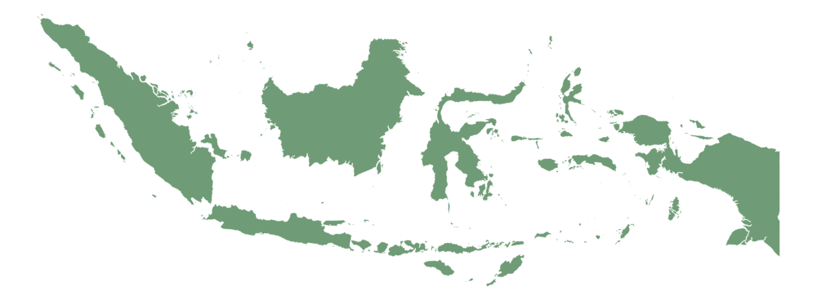



Managing Religious Diversity in the Global Era: Lessons from Indonesia.
Prof. Dr.
Muhsin Mahfudz,
M.Th.I
UIN Alauddin Makassar

Slide 2


INDONESIA, Destiny of diversity
Bhinneka Tunggal Ika (Unity in Diversity)
Sila Pertama: Ketuhanan Yang Maha Esa (Belief in the one and only God)
Islam: 87,2%), Chirtianity 6,9%, Catholic 2,9%, Hinduism 1,7%), Buddhism 0,7%, Confucianism 0,05% - (BPS, 2024)

Slide 3
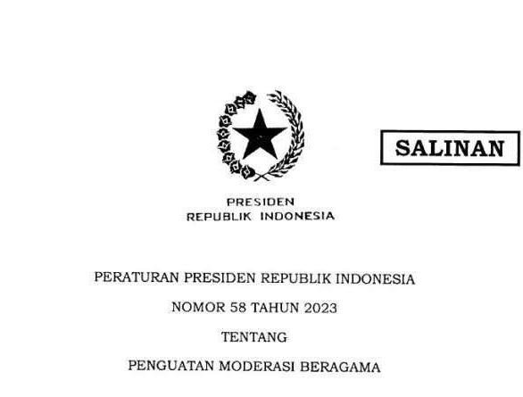
The state's involvement in governing religious diversity.
UUD 1945, Chapter 29: he State guarantees the freedom of every resident to profess his/her own religion and to worship according to his/her religion and belief.
Presidential Regulation Number 58 of 2023 on the Strengthening of Religious Moderation
Joint Ministerial Regulation (SKB) of the Minister of Religious Affairs and the Minister of Home Affairs Numbers 8 and 9 of 2006, concerning the Establishment of Houses of Worship
Minister of Religious Affairs' policies on spirituality-based moderation, the strengthening of moderation houses, and ecotheology

Slide 4
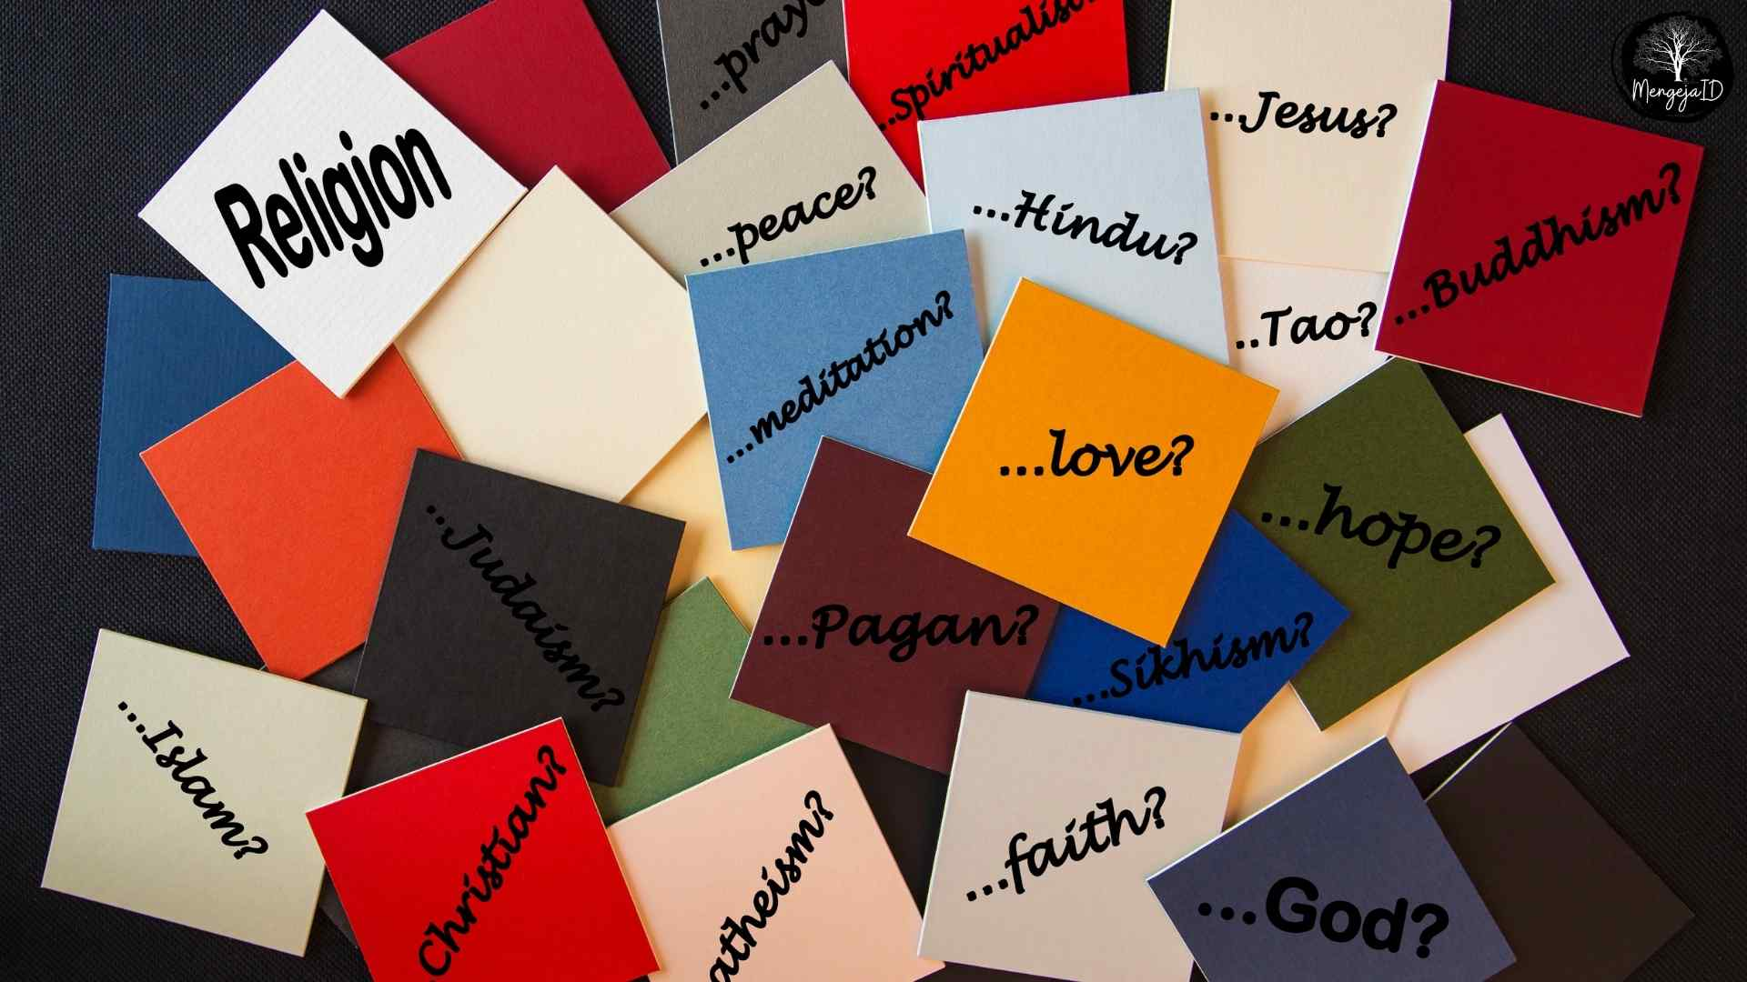
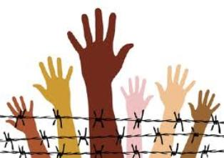
Challenges of religious diversity governance: The Indonesian case
Challenges within the digital sphere
2020-2023: 12 cases; 64,7% (internally Islam), 17,6% (Christianity), 13,7% (Catholic) (Ellina Dewi, Innovative, 3.6 (2023)
56% Gen-Z Intolerance toward different religious groups through social media platforms (PPIM, 2024)
Religious Ideology
Violations of freedom of religion and belief (KBB) 2024-2025: 32 cases by intolerant organizations (KontraS, 2025)
Low sense of national commitment
A study involving 171 high schools in Jakarta and Bandung reveals that students are exposed to radicalism, showing support for terrorism and the replacement of the Pancasila. (Setara, 2022)

Slide 5

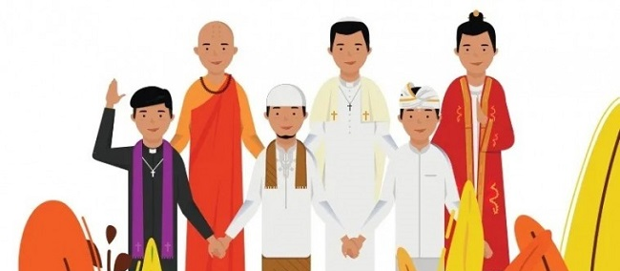
Peran UIN Alauddin
Mengelola Keberagaman
The Rector’s Pancacita Vision: Deep-seated Religious Moderation.
House of Religious Moderation
Integrated curriculum
Research and community service based on religious moderation
Training of Trainers (ToT) on Religious Moderation

Slide 6

Thank You

